Slide 1
HTML
T-level

Slide 2
tags
<p> hello world! </p>
<p> this is <b>bold</b> text </p>
<p> this is <i>italic</i>. </p>
<img src=“kite.jpg”>

Slide 3
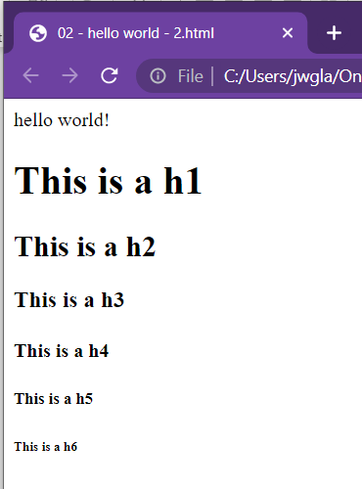
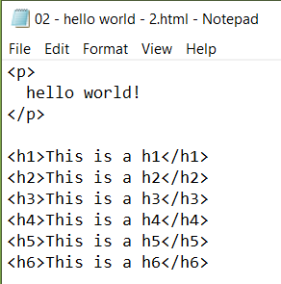
Heading tags

Slide 4
images
Save to the same folder as your web page
Use the following tag to show your image
<img src=“kite.jpg”>

Slide 5
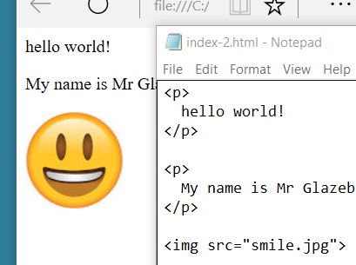

Slide 6


Vcentre2.truro.local
Log in
OneDrive
Check your code
VSCode

Slide 7
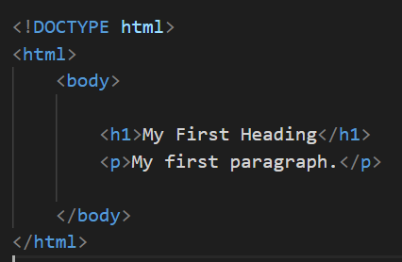
More tags!
template.html

Slide 8
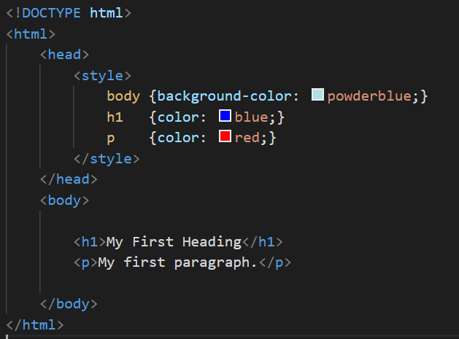
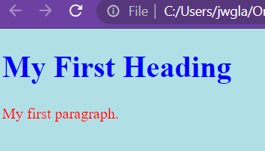

Slide 9
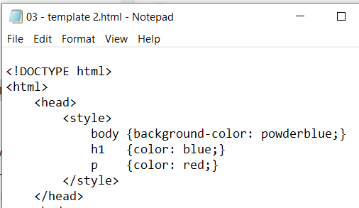

Slide 10
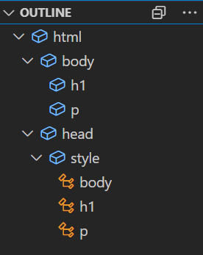

Slide 11
Find more colours!
Research HTML colours
HEX colours
Fonts
Add these into your web page

Slide 12
styles
Styles are written in CSS (cascading style sheets)
They use { and } and ;
CSS is not HTML
Research and understand the differences
Styles can be in a separate file, in the <head> or in a tag
https://www.w3schools.com/css/

Slide 13
